Slide 1

Topic 3
Data Visualization Using Matplotlib
Official (Open) Non-Sensitive

Slide 2
Contents
Contents
Intro to Matplotlib
A first taste of Matplotlib
Adding Legends, Set Axis Limits, Add xticks/yticks
Controlling Line Properties
Subplots methods
Working with multiple figures
Saving Figures
Working with Text
Bar charts
Piecharts
Histograms
Scatter Plots
Box Plots
Display images
Interactive Charts
Official (Open) Non-Sensitive

Slide 3
Introduction to Matplotlib
Official (Open) Non-Sensitive
Notes:
https://matplotlib.org/users/intro.html
https://matplotlib.org/examples/pylab_examples/subplots_demo.html
http://www.python-course.eu/matplotlib_multiple_figures.php

Slide 4
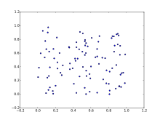
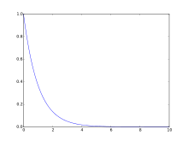
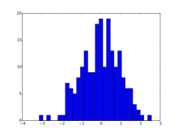
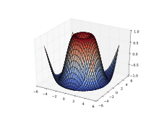
What is Matplotlib?
Introduction to Pandas
Matplotlib is a library for making 2D plots of arrays in Python
The latest version of Matplotlib (as of Nov 2017) is 2.1.0
Official (Open) Non-Sensitive

Slide 5
Matplotlib is both easy yet powerful
Introduction to Matplotlib
Produces publication quality figures in a variety of hardcopy formats and interactive environments across platforms
Can be used in Python scripts, Jupyter notebook, web application servers, and four graphical user interface toolkits
For simple plotting, the pyplot module provides a MATLAB-like interface, particularly when combined with IPython
For the power user, you have full control of line styles, font properties, axes properties, etc, via an object oriented interface or via a set of functions familiar to MATLAB users
Official (Open) Non-Sensitive

Slide 6
Installing Matplotlib
Introduction to Matplotlib
The latest version of Matplotlib (as of Nov 2017) is 2.1.0
If you don’t already have Python installed, start off with Anaconda, which has matplotlib and many of its dependencies, plus other useful packages, preinstalled.
For standard Python installations, install matplotlib using pip:
sudo apt-get install python-matplotlib
sudo yum install python-matplotlib
python -m pip install -U pip setuptools
python -m pip install matplotlib
Official (Open) Non-Sensitive

Slide 7
Getting Started with Matplotlib
Official (Open) Non-Sensitive

Slide 8
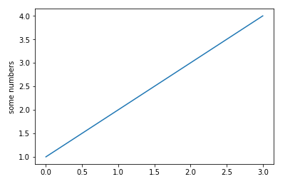
Plot a line graph (supply y values only)
Getting started with Matplotlib
import matplotlib.pyplot as plt
plt.plot([1,2,3,4])
plt.ylabel('some numbers')
plt.show()
If you provide a single list or array to the plot() command, matplotlib assumes it is a sequence of y values, and automatically generates the x values for you
Since python ranges start with 0, the default x vector has the same length as y but starts with 0
Hence the x data are [0,1,2,3].
Official (Open) Non-Sensitive

Slide 9
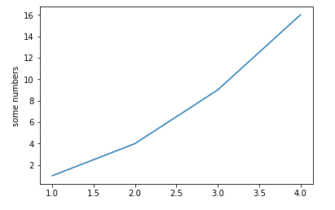
Plot a line graph (supply y+x values)
Getting started with Matplotlib
import matplotlib.pyplot as plt
plt.plot([1, 2, 3, 4], [1, 4, 9, 16])
plt.ylabel('some numbers')
plt.show()
To plot x versus y, you can issue the commands above
Official (Open) Non-Sensitive

Slide 10
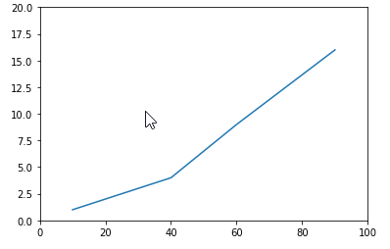
Plot a line graph (specify x and y axis range)
Getting started with Matplotlib
import matplotlib.pyplot as plt
plt.plot([10, 40, 60, 90], [1, 4, 9, 16])
plt.axis([0, 100, 0, 20])
plt.show()
To further customize the axis labels, you can call the axis method with the x range and y range as shown a bove
The axis() command in the example above takes a list of [xmin, xmax, ymin, ymax] and specifies the viewport of the axes.
Official (Open) Non-Sensitive

Slide 11
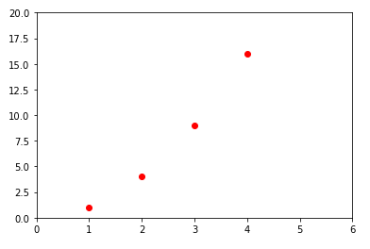
Plot a line graph (specify color and pattern)
Getting started with Matplotlib
import matplotlib.pyplot as plt
plt.plot([1,2,3,4], [1,4,9,16], 'ro')
plt.axis([0, 6, 0, 20])
plt.show()
You can specify a third argument which is the format string that indicates the color and line type of the plot
The default format string is 'b-' which is a solid blue line
To plot the above with red circles, you would use 'ro' instead
Refer to link below for more marker styles https://matplotlib.org/api/markers_api.html
Official (Open) Non-Sensitive
Notes:
https://matplotlib.org/api/markers_api.html

Slide 12
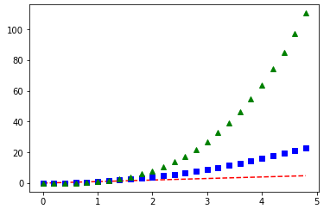
Plot a line graph (with numpy arrays)
Getting started with Matplotlib
import numpy as np
import matplotlib.pyplot as plt
# Create numpy array with values # between 0 and 5 in steps of 0.2
t = np.arange(0, 5, 0.2)
plt.plot(t, t, 'r--', t, t**2, 'bs', t, t**3, 'g^')
plt.show()
Though the previous examples show how matplotlib is used with lists, generally, matplotlib is used with numpy arrays for data processing
The example above illustrates a plotting several lines with different format styles using numpy arrays.
Official (Open) Non-Sensitive
Notes:
https://matplotlib.org/api/markers_api.html

Slide 13
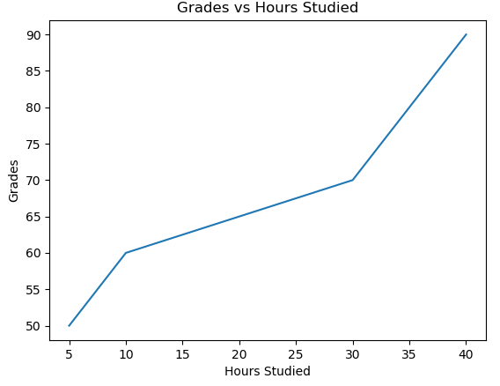
Add titles and labels
Getting started with Matplotlib
import matplotlib.pyplot as plt
plt.title('Grades vs Hours Studied')
plt.xlabel('Hours Studied')
plt.ylabel('Grades')
plt.plot([5,10,30,40], [50,60,70,90])
plt.show()
Official (Open) Non-Sensitive

Slide 14
 | description
'-' | solid line style
'--' | dashed line style
'-.' | dash-dot line style
':' | dotted line style
'.' | point marker
',' | pixel marker
'o' | circle marker
's' | square marker
'p' | pentagon marker
'*' | star marker
'h' | hexagon1 marker
'H' | hexagon2 marker
'+' | plus marker
'x' | x marker
 | description
'v' | triangle_down marker
'^' | triangle_up marker
'<' | triangle_left marker
'>' | triangle_right marker
'1' | tri_down marker
'2' | tri_up marker
'3' | tri_left marker
'4' | tri_right marker
'D' | diamond marker
'd' | thin_diamond marker
'|' | vline marker
'_' | hline marker
The following format string characters are accepted to control the line style or marker
Official (Open) Non-Sensitive

Slide 15
 | color
b’ | blue
‘g’ | green
‘r’ | red
‘c’ | cyan
‘m’ | magenta
‘y’ | yellow
‘k’ | black
‘w’ | white
The following color abbreviations are supported
In addition, you can specify colors in other ways
full names ('green')
hex strings ('#008000')
RGB or RGBA tuples ((0,1,0,1))
grayscale intensities as a string ('0.8')
Official (Open) Non-Sensitive

Slide 16
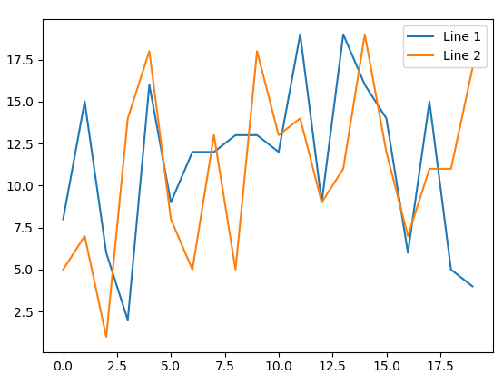
Add legend to a plot (Example 1)
Adding Legends
Call plt.legend to add a legend to a plot
import numpy as np
import matplotlib.pyplot as plt
line_1 = np.random.randint(1,20,20)
line_2 = np.random.randint(1,20,20)
plt.plot(line_1,label="Line 1")
plt.plot(line_2,label="Line 2")
legend = plt.legend()
plt.show()
Official (Open) Non-Sensitive

Slide 17
Set axis limits (axis method)
Set Axis Limits
import matplotlib.pyplot as plt
plt.plot([1,2,3,4], [1,4,9,16], 'ro')
plt.axis([0, 6, 0, 20])
plt.show()
Official (Open) Non-Sensitive

Slide 18
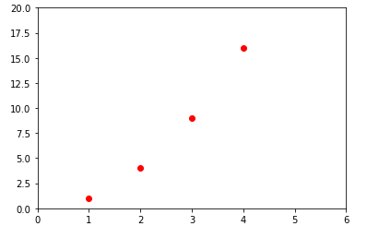
Set axis limits (ylim and xlim method)
Set Axis Limits
import matplotlib.pyplot as plt
plt.plot([1,2,3,4], [1,4,9,16], 'ro')
plt.xlim(0,6)
plt.ylim(0,20)
plt.show()
Official (Open) Non-Sensitive

Slide 19
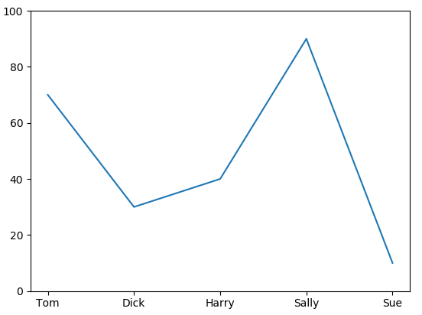
Add x-ticks
Adding x-ticks, y-ticks
Call plt.xticks to add xticks to a plot
import numpy as np
import matplotlib.pyplot as plt
y = [70,30,40,90,10]
xlabels = ('Tom', 'Dick', 'Harry', 'Sally', 'Sue')
plt.xticks(np.arange(5),xlabels)
plt.ylim(0,100)
plt.plot(y)
plt.show()
Official (Open) Non-Sensitive

Slide 20
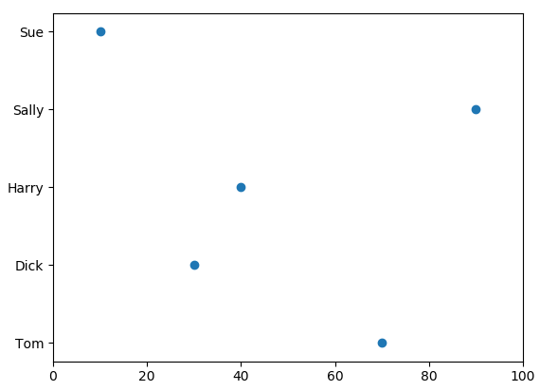
Add y-ticks
Adding x-ticks, y-ticks
Call plt.yticks to add xticks to a plot
import numpy as np
import matplotlib.pyplot as plt
x = [70,30,40,90,10]
ylabels = ('Tom', 'Dick', 'Harry', 'Sally', 'Sue')
plt.yticks(np.arange(5),ylabels)
plt.xlim(0,100)
plt.scatter(x, np.arange(5))
plt.show()
Official (Open) Non-Sensitive

Slide 21
Controlling Line Properties
Official (Open) Non-Sensitive

Slide 22
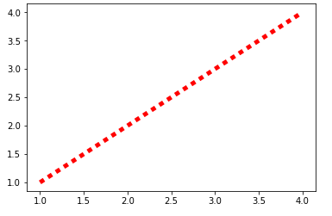
Using keyword args with plot method
Controlling Line Properties
import matplotlib.pyplot as plt
x,y = [1,2,3,4],[1,2,3,4]
plt.plot(x, y, linewidth=5, linestyle="dotted",
color="red")
plt.show()
Lines have many attributes that you can set: linewidth, dash style, antialiased
One easy way to control the line attributes is to add them as keyword args when you call the plot method
Official (Open) Non-Sensitive

Slide 23
Using subplots method
Working with multiple plots and figures
plt.subplots() is a function that returns a tuple containing a figure and axes object(s)
Thus when using plt.subplots() you unpack this tuple into the variables fig and ax
fig, ax = plt.subplots()
Having a fig object is useful if you want to change figure-level attributes or save the figure as an image file later (e.g. with fig.savefig('yourfilename.png')
Having an axes object is useful if you want to change axis-level attributes (e.g. customize ticks, pan/zoom axis etc)
Official (Open) Non-Sensitive

Slide 24
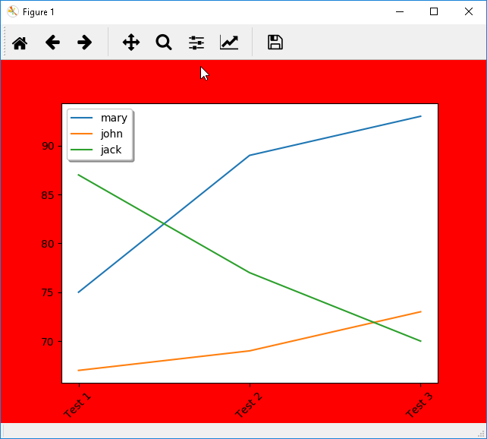
Using fig and ax objects
Working with multiple plots and figures
import numpy as np
import matplotlib.pyplot as plt
x_labels = ["Test 1", "Test 2", "Test 3"]
mary = [75,89,93]
john = [67,69,73]
jack = [87,77,70]
fig,ax = plt.subplots()
fig.set_facecolor("red")
ax.set_xticks(np.arange(3)) ax.set_xticklabels(x_labels, rotation=45)
ax.plot(mary,label="mary") ax.plot(john,label="john") ax.plot(jack,label="jack")
legend = ax.legend(loc='upper left', shadow=True)
plt.show()
Official (Open) Non-Sensitive

Slide 25
Plotting multiple plots or multiple figures
Working with multiple figures and axes
Matplotlib allows you to plot multiple plots on a single figure or plot multiple plots on multiple figures using the subplot and figure commands
The examples that follow in this section illustrate how you can plot multiple subplots on a single figure, as well as plot them on different figures, which allows you to save them separately as individual image files
Official (Open) Non-Sensitive
Notes:
https://stackoverflow.com/questions/34162443/why-do-many-examples-use-fig-ax-plt-subplots-in-matplotlib-pyplot-python
http://matplotlib.org/api/pyplot_api.html#matplotlib.pyplot.subplots

Slide 26
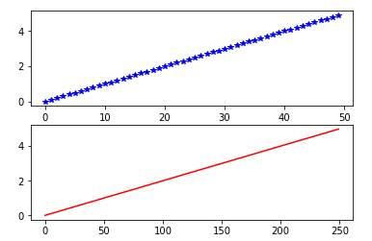
Two subplots on 1 figure (Example #1)
Working with multiple figures and axes
import numpy as np
import matplotlib.pyplot as plt
t1 = np.arange(0.0, 5.0, 0.1)
t2 = np.arange(0.0, 5.0, 0.02)
plt.figure(1)
plt.subplot(211)
plt.plot(t1,'b*')
plt.subplot(212)
plt.plot(t2,'r-')
plt.show()
Create a multi-plot by first declaring the figure with a unique reference number, then the subplot method with a unique reference number, followed by the plot method
subplot(nrows, ncols, plot_number)
Official (Open) Non-Sensitive

Slide 27
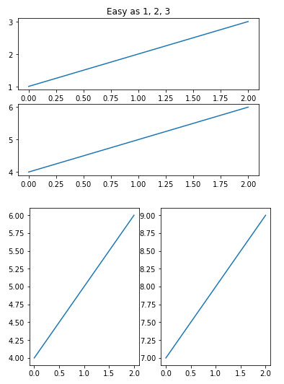
Two figures - each 2 subplots (Example #1)
Working with multiple figures and axes
import matplotlib.pyplot as plt
plt.figure(1) # first figure
plt.subplot(211) # 2 rows, 1 col, 1st row
plt.plot([1, 2, 3])
plt.subplot(212) # 2 rows, 1 col, 2nd row
plt.plot([4, 5, 6])
plt.figure(2) # second figure
plt.subplot(121) # 2nd subplot 1st figure
plt.plot([4, 5, 6])
plt.subplot(122) # 2nd subplot 2nd figure
plt.plot([7, 8, 9])
plt.figure(1) # figure 1 current;
plt.subplot(211)
plt.title('Easy as 1, 2, 3')
Official (Open) Non-Sensitive
Notes:
You can create multiple figures by using multiple figure() calls with an increasing figure number. Of course, each figure can contain as many axes and subplots as your heart desires

Slide 28
How to change size of figure
Working with multiple figures and axes
plt.figure(figsize=(20,10))
Method 1
plt.rcParams["figure.figsize"] = [16,9]
Method 2
fig = plt.figure()
fig.set_figheight(value_height)
fig.set_figwidth(value_width)
Method 3
Official (Open) Non-Sensitive

Slide 29
How to clear a figure
Working with multiple figures and axes
fig1 = plt.figure(figsize=(20,10))
fig1.clf()
Official (Open) Non-Sensitive

Slide 30
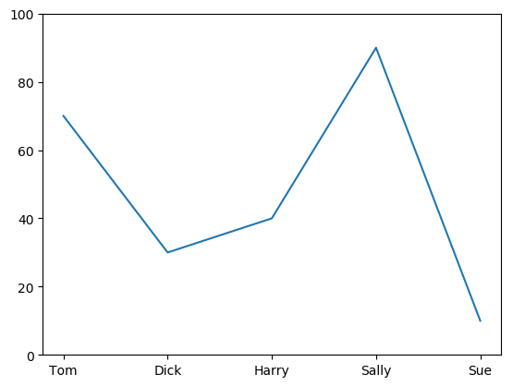
Save a figure
Saving a figure
import numpy as np
import matplotlib.pyplot as plt
y = [70,30,40,90,10]
xlabels = ('Tom', 'Dick', 'Harry', 'Sally', 'Sue')
plt.xticks(np.arange(5),xlabels)
plt.ylim(0,100)
plt.plot(y)
# Save the figure as a PNG.
# You can also save it as a PDF, JPEG, etc.
# Just change the file extension in this call.
# bbox_inches="tight" removes all whitespace on the edges of your plot.
plt.savefig("mygraph.png", bbox_inches="tight")
Official (Open) Non-Sensitive

Slide 31
Working with Text
Official (Open) Non-Sensitive

Slide 32
Working with Text
Working with Text
The following commands are used to create text in the pyplot interface
The text() command can be used to add text in an arbitrary location
xlabel(), ylabel() and title() are used to label the axes
All of these functions create and return a matplotlib.text.Text() instance, which can be configured with a variety of font and other properties
Method | Description
text | add text at an arbitrary location to the Axes
xlabel | add a label to the x-axis
ylabel | add a label to the y-axis
title | add a title to the Axes
figtext | add text at an arbitrary location to the Figure
subtitle | add a title to the Figure
annotate | add an annotation, with optional arrow, to the Axes
Official (Open) Non-Sensitive

Slide 33
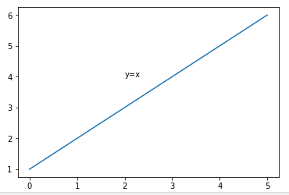
Add text at a location
Working with Text
import numpy as np
import matplotlib.pyplot as plt
fig = plt.figure(1)
ax = fig.add_subplot(111)
ax.text(2, 4, 'y=x', fontsize=10)
plt.plot([1,2,3,4,5,6])
plt.show()
The text() command places text at an arbitrary position
Official (Open) Non-Sensitive

Slide 34
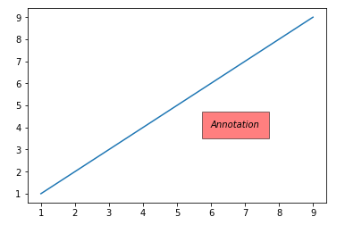
Annotating with Text with Box
Working with text
import numpy as np
import matplotlib.pyplot as plt
x1 = np.arange(1,10,2)
y1 = np.arange(1,10,2)
fig = plt.figure(1)
ax = fig.add_subplot(111)
ax.text(6, 4, 'Annotation', style='italic',
bbox={'facecolor':'red', 'alpha':0.5, 'pad':10})
plt.plot(x1,y1)
plt.show()
Official (Open) Non-Sensitive

Slide 35
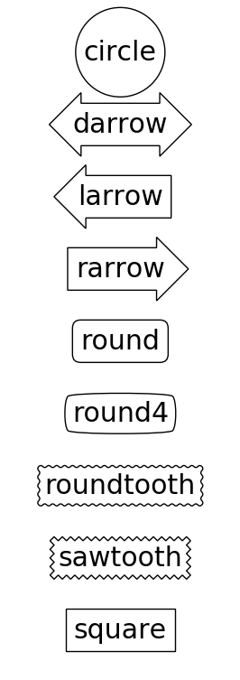
 | description
Circle | circle | pad=0.3
DArrow | darrow | pad=0.3
LArrow | larrow | pad=0.3
RArrow | rarrow | pad=0.3
Round | round | pad=0.3,rounding_size=None
Round4 | round4 | pad=0.3,rounding_size=None
Roundtooth | roundtooth | pad=0.3,tooth_size=None
Sawtooth | sawtooth | pad=0.3,tooth_size=None
Square | square | pad=0.3
Official (Open) Non-Sensitive

Slide 36
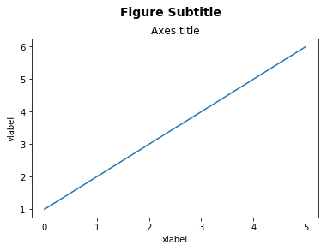
Add labels and subtitles
Working with Text
import matplotlib.pyplot as plt
fig = plt.figure()
fig.suptitle('Figure Subtitle', fontsize=14, fontweight='bold')
ax = fig.add_subplot(111)
fig.subplots_adjust(top=0.85)
ax.set_title('Axes title')
ax.set_xlabel('xlabel')
ax.set_ylabel('ylabel')
plt.plot([1,2,3,4,5,6])
plt.show()
Official (Open) Non-Sensitive

Slide 37
Bar charts
Official (Open) Non-Sensitive

Slide 38
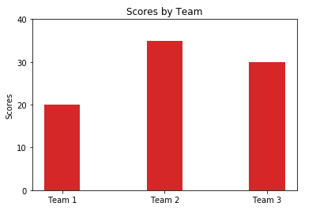
Bar Charts (Example #1)
Bar Charts
import numpy as np
import matplotlib.pyplot as plt
teams = np.arange(3)
scores = (20, 35, 30)
width = 0.35
p1t = plt.bar(teams, scores, width, color='#d62728')
plt.ylabel('Scores')
plt.title('Scores by Team')
plt.xticks(teams, ('Team 1', 'Team 2', 'Team 3'))
plt.yticks(np.arange(0, 50, 10))
plt.show()
Official (Open) Non-Sensitive

Slide 39
Pie charts
Official (Open) Non-Sensitive

Slide 40
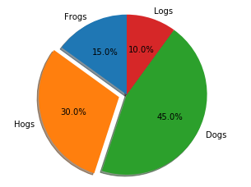
Pie Charts (Example #1)
Pie Charts
import matplotlib.pyplot as plt
# Slices are ordered, anti-clockwise
labels = 'Frogs', 'Hogs', 'Dogs', 'Logs'
sizes = [15, 30, 45, 10]
explode = (0, 0.1, 0, 0) # Explode 2nd
fig1, ax1 = plt.subplots()
ax1.pie(sizes, explode=explode, labels=labels, autopct='%1.1f%%',
shadow=True, startangle=90)
# Eq aspect ratio draws pie as circle
ax1.axis('equal')
plt.show()
Official (Open) Non-Sensitive

Slide 41
Pie Charts (Example #2)
Pie Charts
import numpy as np
import matplotlib.pyplot as plt
data = np.loadtxt('data.csv', skiprows=1, dtype=[('year','i8'), ('level_1','U50'), ('value','i8')], delimiter=",")
# Extract rows containing 1965 only
data_1965 = data[data['year']==1965]
# Extract rows containing required keywords only
data_ethnic = data_1965[np.isin(data_1965['level_1'], ['Total Chinese', 'Total Malays', 'Total Indians', 'Other Ethnic Groups (Total)'])]
labels = data_ethnic['level_1']
values = data_ethnic['value']
Official (Open) Non-Sensitive

Slide 42
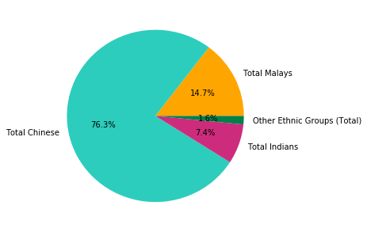
Pie Charts (Example #2)
Pie Charts
colors = ['#FFA500', '#2CCDBD', '#CD2C7D', '#057F4A'] explode = (0.1, 0, 0, 0)
plt.figure(figsize=(5,5))
plt.pie(values, labels=labels, colors=colors, autopct='%1.1f%%')
plt.show()
Official (Open) Non-Sensitive

Slide 43
Histograms
Official (Open) Non-Sensitive
Notes:
https://matplotlib.org/api/pyplot_api.html?highlight=hist#matplotlib.pyplot.hist

Slide 44
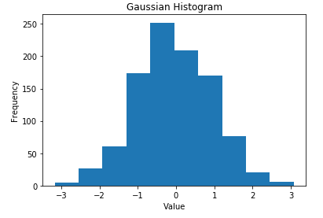
Example #1 - Single dataset
Histograms
import numpy as np
import matplotlib.mlab as mlab
import matplotlib.pyplot as plt
gaussian_numbers = np.random.randn(1000)
plt.hist(gaussian_numbers)
plt.title("Gaussian Histogram")
plt.xlabel("Value")
plt.ylabel("Frequency")
plt.show()
Official (Open) Non-Sensitive

Slide 45
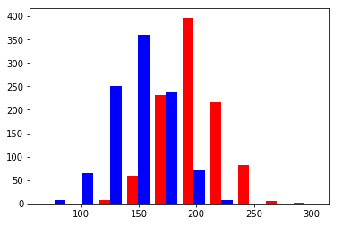
Example #2 - Multiple Dataset
Histograms
import numpy as np
import matplotlib.pyplot as plt
fig = plt.figure()
x = 200 + 25*np.random.randn(1000)
y = 150 + 25*np.random.randn(1000)
n, bins, patches = plt.hist( [x, y], color=['red','blue'])
plt.show()
Official (Open) Non-Sensitive

Slide 46
Scatter Plots
Official (Open) Non-Sensitive
Notes:
https://matplotlib.org/api/pyplot_api.html?highlight=scatter#matplotlib.pyplot.scatter

Slide 47
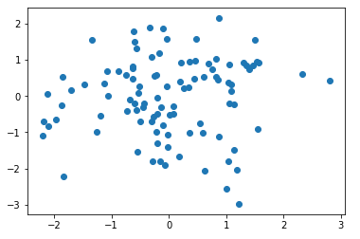
Scatter Plots (Example #1)
Scatter Plots
import numpy as np
import matplotlib.pyplot as plt
x = np.random.randn(100)
y = np.random.randn(100)
plt.scatter(x,y)
plt.show()
Official (Open) Non-Sensitive

Slide 48
Scatter Plots (Example #2)
Scatter Plots
The local ice cream shop keeps track of how much ice cream they sell versus the noon temperature on that day.
Here are their figures for the last 12 days
See the next slide for how the same data is plotted as a scatter plot
Temperature | Ice-cream sales
14.2 | 215
16.4 | 325
11.9 | 185
15.2 | 332
18.5 | 406
22.1 | 522
19.4 | 412
25.1 | 614
23.4 | 544
18.1 | 421
22.6 | 445
17.2 | 408
Official (Open) Non-Sensitive

Slide 49
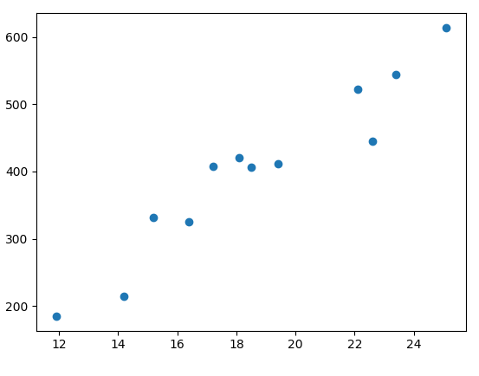
Scatter Plots (Example #2)
Scatter Plots
import numpy as np
import matplotlib.pyplot as plt
data = np.loadtxt("icecream.csv",delimiter=",")
# split the data into x and y arrays
x,y = np.split(data, 2, axis=1)
plt.scatter(x,y)
plt.show()
Official (Open) Non-Sensitive

Slide 50
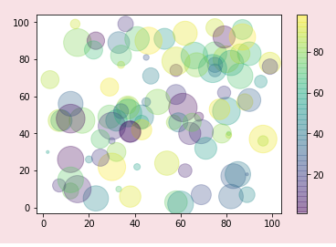
Scatter Plots (Example #3)
Scatter Plots
import numpy as np
import matplotlib.pyplot as plt
x = np.random.randint(1,100,100)
y = np.random.randint(1,100,100)
colors = np.random.randint(1,100,100)
sizes = 10* np.random.randint(1,100,100)
plt.scatter(x, y, c=colors, s=sizes, alpha=0.3,
cmap='viridis')
plt.colorbar(); # show color scale
Official (Open) Non-Sensitive

Slide 51
Box Plots
Official (Open) Non-Sensitive
Notes:
https://matplotlib.org/api/pyplot_api.html?highlight=scatter#matplotlib.pyplot.scatter

Slide 52
Box Plots (Example #1)
Box Plots
This example shows how you can create a box-plot that shows the median of the number of hours 6 students sleep in a week
import matplotlib.pyplot as plt
import numpy as np
# No.hours 6 students sleep in a week data = np.array([(8,5,7,3,4,5,9),(6,5,6,8,8,8,6),(4,5,7,6,6,7,9), (3,5,7,8,8,7,6),(3,6,7,7,7,6,6),(8,7,6,6,7,7,9)])
labels = np.array(['Sun','Mon', 'Tue','Wed','Thu','Fri','Sat'])
plt.boxplot(data,labels=labels)
plt.show()
Official (Open) Non-Sensitive

Slide 53
Box Plots (Example #2)
Box Plots
This example shows how you can create a colored box-plot that shows the median of the test marks scored in 3 different subjects
import matplotlib.pyplot as plt
import numpy as np
data = np.array([(90,80,70),(83,74,65),(66,85,60)])
labels = np.array(['Math','English','Science'])
bplot1 = plt.boxplot(data,labels=labels, patch_artist=True)
colors = ['pink', 'lightblue', 'lightgreen']
patchcolor = list(zip(bplot1['boxes'], colors))
for patch, color in patchcolor:
patch.set_facecolor(color)
plt.show()
Official (Open) Non-Sensitive

Slide 54
Box Plots (Example #3)
Box Plots
This example shows how you can overlay the numeric value of median and outliers in a boxplot
import matplotlib.pyplot as plt
import numpy as np
data = np.array([(90,80,70),(83,74,65),(66,85,60),(20,79,100),(95,82,72),(84,78,67)])
labels = np.array(['Math','English','Science'])
bplot = plt.boxplot(data,labels=labels, patch_artist=True, vert=False)
for line in bplot['medians']:
print(line)
# get position data for median line
x, y = line.get_xydata()[1] # top of median line
# overlay median value
plt.text(x, y, 'Median:{:.1f}'.format(x),
horizontalalignment='center',fontsize=8) # draw above, centered
Official (Open) Non-Sensitive

Slide 55
Box Plots (Example #3)
Box Plots
This example shows how you can overlay the numeric value of median and outliers in a boxplot
fliers = []
for line in bplot['fliers']:
ndarray = line.get_xydata()
print(ndarray)
if (len(ndarray)>0):
max_flier = ndarray[:,0].max()
max_flier_index = ndarray[:,0].argmax()
x = ndarray[max_flier_index,0] #where to plot the flier text in x position
y = ndarray[max_flier_index,1] #where to plot the flier text in y position
print("Flier: " + str(x) + "," + str(max_flier))
plt.text(x,y,'Flier:{:.1f}'.format(max_flier),horizontalalignment='center',fontsize=10,color='green')
plt.show()
Official (Open) Non-Sensitive

Slide 56
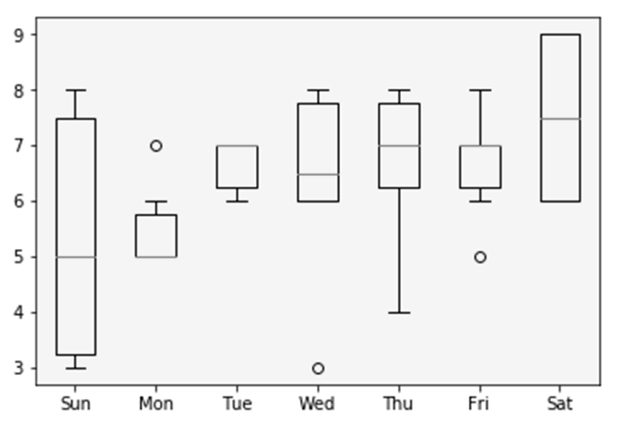
Output from Example 1
From the output, we can tell that most of the students do get more than 6 hours of sleep on most days, and do especially well on Saturdays.
However, there is a huge disparity of sleep patterns on Sunday where some students get much less sleep than others.
Most students sleep very little on Mondays with little difference. The sleeping patterns of Tue, and Fri also have little variation.
Thu sleep patterns vary by quite a lot though
Official (Open) Non-Sensitive

Slide 57
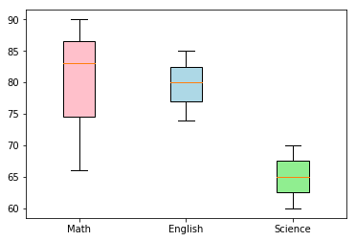
Output from Example 2
Official (Open) Non-Sensitive

Slide 58
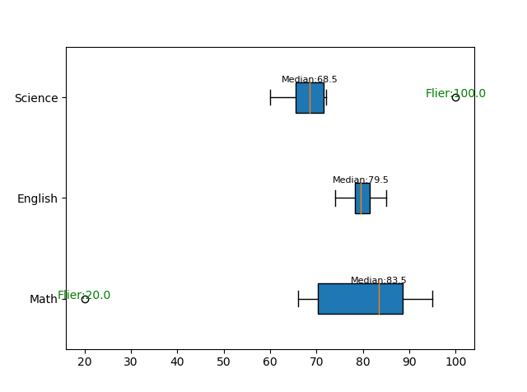
Output from Example 3
Official (Open) Non-Sensitive

Slide 59
Display Images Intro
Displaying Images in Matplotlib
The most common way to plot images in Matplotlib is with imshow method
The example on the next slide demonstrates how to display an image using the imgshow method
If you want to explore more advanced image display and manipulation methods, you can check out this link:
https://matplotlib.org/users/image_tutorial.html
Official (Open) Non-Sensitive
Notes:
https://matplotlib.org/users/event_handling.html

Slide 60
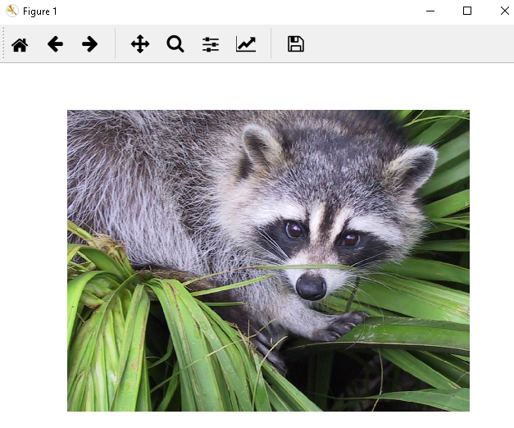
Display Images Example 1
Displaying Images in Matplotlib
import matplotlib.pyplot as plt
image = plt.imread("data/face.png")
fig, ax = plt.subplots()
ax.imshow(image)
ax.axis('off')
plt.show()
Official (Open) Non-Sensitive
Notes:
https://matplotlib.org/users/event_handling.html

Slide 61
Interactive Chart (Example #1 - Page 1)
Interactive Charts
This example shows how you can create an interactive chart that prints to the console information on the x,y position of the user's mouse click
import matplotlib.pyplot as plt
import numpy as np
fig, ax = plt.subplots()
ax.plot(np.random.rand(10))
def onclick(event):
print('{} click:button={},x={},y={},xdata={:.2f},ydata={:.2f}'.format ('double' if event.dblclick else 'single', event.button,event.x, event.y, event.xdata, event.ydata))
cid = fig.canvas.mpl_connect('button_press_event', onclick)
plt.show()
Official (Open) Non-Sensitive
Notes:
https://matplotlib.org/users/event_handling.html

Slide 62
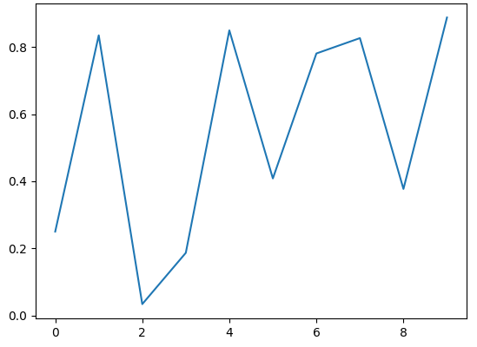

Output from Interactive Chart Example 1
Using the code below to r espond to mouse click event
print('{} click: button={}, x={}, y={}, xdata={:.2f}, ydata={:.2f}'.format('double' if event.dblclick else 'single',event.button,event.x, event.y, event.xdata, event.ydata))
Official (Open) Non-Sensitive

Slide 63
Interactive Chart (Example #2 - Page 1)
Interactive Charts
This example shows how you can create an interactive chart that displays the text annotation "You clicked here" at whichever x,y position that was clicked by the user
import matplotlib.pyplot as plt
import numpy as np
fig, ax = plt.subplots()
ax.plot(np.random.rand(10))
txt = None
Official (Open) Non-Sensitive
Notes:
https://matplotlib.org/users/event_handling.html

Slide 64
Interactive Chart (Example #2 - Page 2)
Interactive Charts
def onclick(event):
global txt
txt = plt.text(event.xdata, event.ydata, "You clicked here")
fig.canvas.draw()
def offclick(event):
txt.remove()
fig.canvas.draw()
fig.canvas.mpl_connect('button_press_event', onclick)
fig.canvas.mpl_connect('button_release_event', offclick)
plt.show()
Official (Open) Non-Sensitive
Notes:
https://matplotlib.org/users/event_handling.html

Slide 65
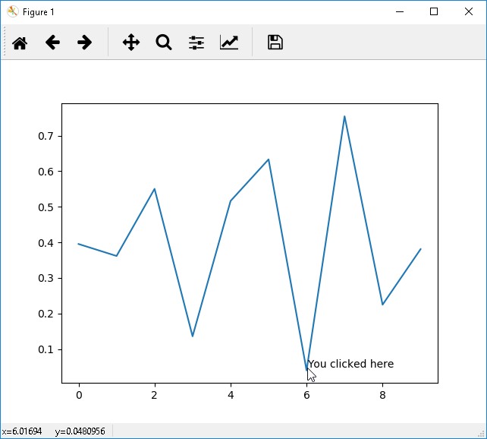
Output from Interactive Chart Example 2
Using the code below to r espond to mouse click event
txt = plt.text(event.xdata, event.ydata, "You clicked here")
Official (Open) Non-Sensitive

Slide 66
End of Topic 3
Official (Open) Non-Sensitive

